Slide 1
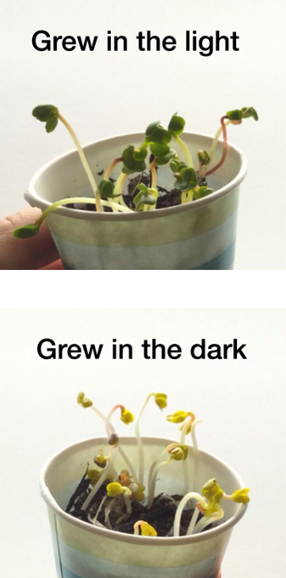
Variables Notes – Page 1
In the following passage, underline or highlight all the key-words and information. Then, answer the questions on the back
In science, a variable is something that we can change or control to see what happens. We use variables to help us figure out why things happen and how they happen. There are three types of variables: independent, dependent, and controlled.
An independent variable is something that we change on purpose to see what effect it has on something else. For example, if we want to see how hot or cold weather affects plants, we might change the temperature and see how the plants grow. In this case, temperature is the independent variable because we're changing it on purpose.
A dependent variable is something that changes as a result of the independent variable. In the plant example, the growth of the plants is the dependent variable because it changes depending on the temperature we set.
A controlled variable is something that we keep the same throughout the experiment so we can be sure that any changes we see are because of the independent variable. For example, if we want to test how different types of soil affect plant growth, we might keep everything else the same (like the amount of water and sunlight the plants get) so we can be sure that any differences we see are because of the soil.
So, by using variables in science experiments, we can learn more about the world around us and how things work!

Slide 2
Variables Notes – Page 2
What is a variable?
______________________________________________________________________
What is an independent variable?
______________________________________________________________________
What is a dependent variable?
______________________________________________________________________
What is a controlled variable?
______________________________________________________________________
What was the experiment they used as an example?
______________________________________________________________________
______________________________________________________________________
In the experiment they used, what was the:
Independent variable? __________________________________________________________________
Dependent variable? __________________________________________________________________
Controlled variables? __________________________________________________________________ __________________________________________________________________ __________________________________________________________________

Slide 3
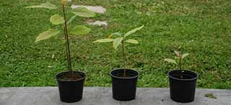

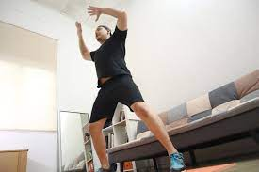

Variables Exercises – Page 1
Below are four examples of experiments. Underline or highlight what you think the different variables are, then answer the questions on the back.
A scientist wants to see how much water it takes to make a plant grow. They water one plant once a day, another plant twice a day, and a third plant three times a day.
An experimenter wants to see if music affects the ability to concentrate. They have two groups of participants, one group listens to classical music while the other group works in silence.
A researcher wants to investigate the effect of exercise on heart rate. They ask participants to rest for five minutes and then perform ten jumping jacks. They then measure their heart rate before and after the exercise.
A scientist wants to see how different colors affect mood. They show participants pictures with different colors and ask them to rate their mood on a scale of 1-10.

Slide 4
Variables Exercises – Page 2
In the first experiment, what was:
The independent variable? ______________________________
The dependent variable? ______________________________
Two controlled variables? ______________________________ ______________________________
In the second experiment, what was:
The independent variable? ______________________________
The dependent variable? ______________________________
Two controlled variables? ______________________________ ______________________________
In the third experiment, what was:
The independent variable? ______________________________
The dependent variable? ______________________________
Two controlled variables? ______________________________ ______________________________
In the fourth experiment, what was:
The independent variable? ______________________________
The dependent variable? ______________________________
Two controlled variables? ______________________________ ______________________________

